Slide 1

Air Quality Prediction Using Machine Learning
Group 1
• Shaik Althaf • Chillakuru Kamakshi Iswarya
• Aditya Borkar • Ithireddy Vigneswari

Slide 2
Project Overview
Objective
Develop a robust regression model using the Air Quality UCI dataset to predict pollutant concentrations, enabling better environmental monitoring and public health decision-making.
Impact
Our model helps monitor pollution levels in real-time, supporting environmental agencies and urban planners in making data-driven decisions for cleaner air initiatives.
01
02
Data Collection
Data Preprocessing
Gather UCI Air Quality dataset
Clean and prepare data for modeling
03
04
Train-Test Split
Model Development
Divide dataset for validation
Build and evaluate regression models

Slide 3

Dataset Specifications
Dataset Source
Data Scale
Air Quality UCI Dataset from the UCI Machine Learning Repository - a trusted source for environmental ML research.
9,358 hourly records collected from March 2004 to February 2005 in a highly polluted Italian urban area.
Key Features
Data Challenge: The dataset contains missing values marked as -200, irregular entries, and features on different scales requiring comprehensive preprocessing.
Pollutant Measurements
CO, NMHC, NOx, NO2 concentrations
Environmental Factors
Temperature, Relative Humidity, Absolute Humidity
Temporal Data
Date and time stamps for trend analysis

Slide 4
Raw Dataset Overview
Sample view of the Air Quality UCI Dataset showing hourly measurements of pollutants and environmental conditions
Comprehensive Coverage
Real-world Complexity
The dataset captures a full year of environmental data, providing seasonal variations crucial for robust model training.
Data reflects actual monitoring challenges including sensor errors, missing readings, and environmental fluctuations.

Slide 5

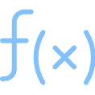

Technical Implementation Stack
Core Python Libraries
Key Functions Applied
Pandas
read_excel()
Data loading, manipulation, and analysis with powerful DataFrame operations
Load dataset from Excel format
drop() & replace()
NumPy
Remove unwanted columns and handle invalid values
Efficient numerical computations and array operations for data processing
fillna()
Impute missing values using forward/backward fill
Scikit-learn
StandardScaler()
Complete ML toolkit for preprocessing, scaling, model training, and evaluation
Normalize features to common scale
train_test_split()
Divide dataset for model validation

Slide 6




Data Quality Challenges
Temporal Structure Issues
Invalid Data Markers
Separate Date and Time columns weren't ML-ready, requiring consolidation into proper datetime format.
Missing sensor readings encoded as -200 values throughout the dataset, requiring systematic identification and handling.
Scattered Missing Values
Scale Inconsistencies
Gaps in measurements across multiple environmental and pollutant features, affecting model training quality.
Features ranging from CO concentrations to temperature values on vastly different scales, hindering model convergence.

Slide 7
Raw Data Sample
Before preprocessing: Notice the separate Date/Time columns and -200 values indicating missing sensor readings
Data Structure Analysis
Quality Assessment
The raw dataset shows typical IoT sensor challenges with inconsistent readings and temporal fragmentation requiring systematic preprocessing.
Initial exploration reveals approximately 15% missing values and significant scale variations across different measurement types.

Slide 8
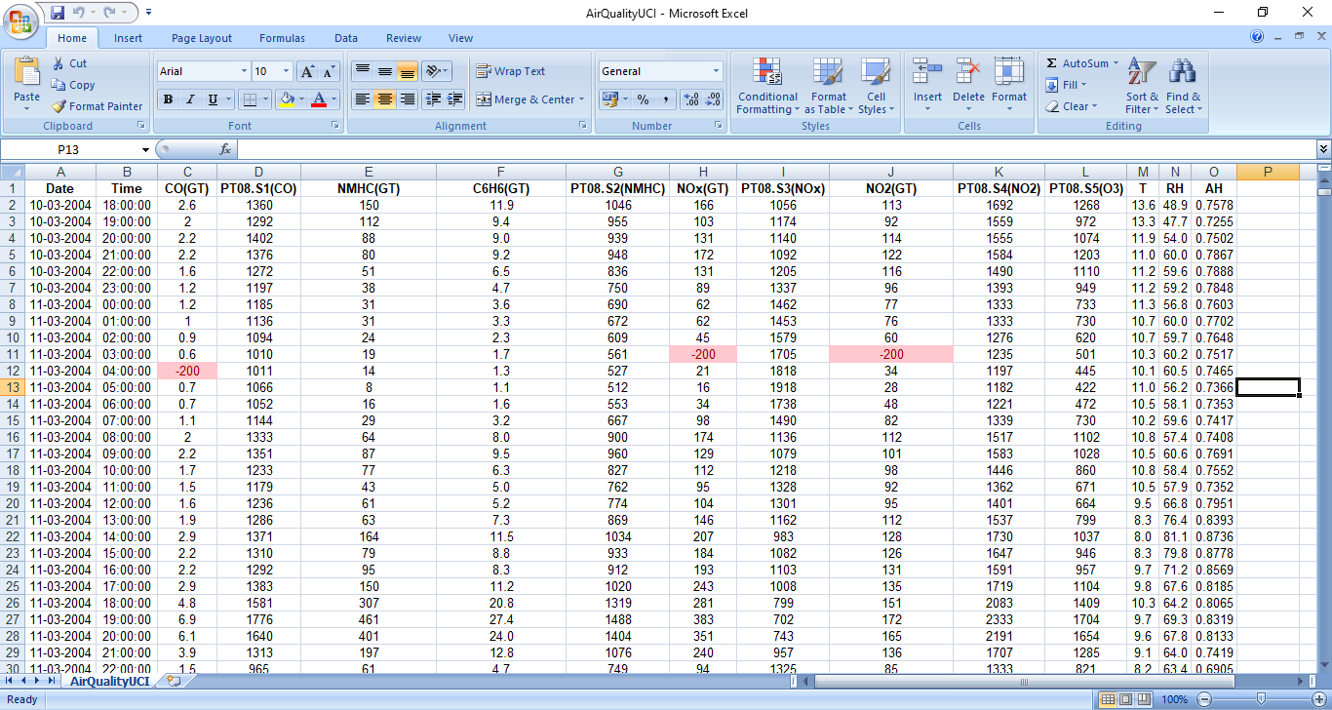
Dataset Before Preprocessing

Slide 9





Comprehensive Data Transformation
Datetime Consolidation
Merged Date and Time columns into unified Datetime feature for better temporal modeling and trend analysis.
Data Cleaning
Systematically replaced all -200 invalid markers with NaN values for proper statistical handling.
Missing Value Imputation
Applied forward fill and backward fill techniques to maintain temporal continuity in sensor measurements.
Feature Standardization
Used StandardScaler to normalize all numeric features, ensuring equal contribution during model training.
Feature Engineering
Created Hour and DayOfWeek features to capture temporal patterns in pollution levels.

Slide 10

Processed Dataset Result
After preprocessing: Clean, standardized data with consolidated datetime features ready for machine learning
0
12
Transformation Success: The preprocessed dataset now features standardized scales, complete temporal information, and engineered features that capture pollution patterns.
Missing Values
Final Features
Complete dataset with no null values
Optimized feature set for modeling
9358
Clean Records
All observations ready for training

Slide 11
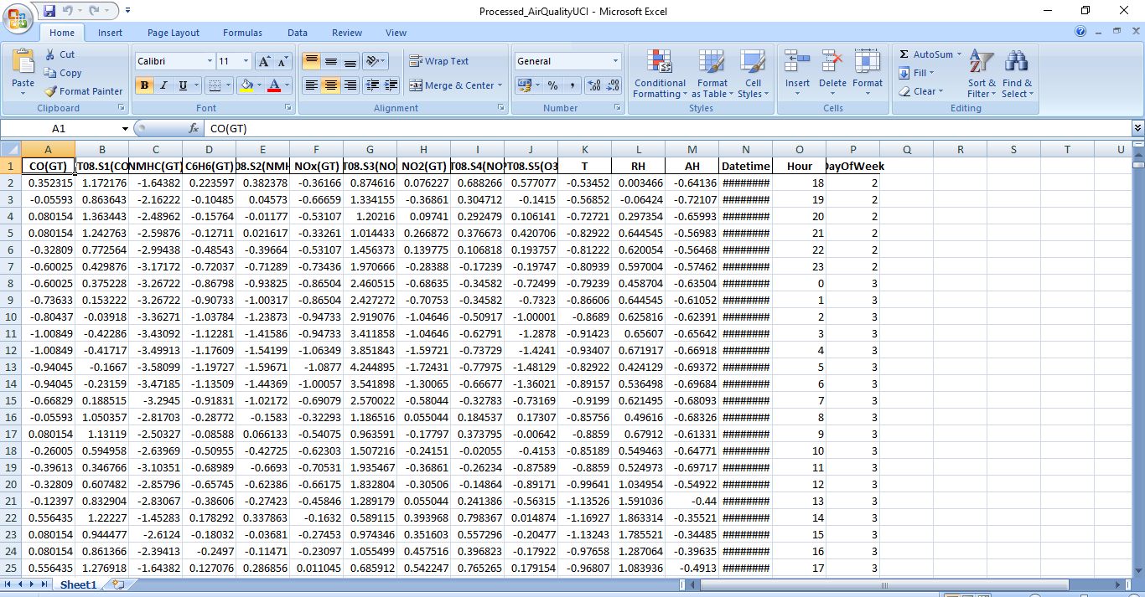
Dataset After Preprocessing

Slide 12


Model Validation Strategy
Train-Test Split Methodology
We implemented a robust validation approach using scikit-learn's train_test_split() function to ensure our model generalizes well to unseen environmental data.
80%
20%
Training Data
Testing Data
Model learns pollution patterns and relationships
Unbiased performance evaluation on new data
Overfitting Prevention
Real-world Validation
By keeping test data completely separate during training, we ensure our model doesn't memorize specific patterns but learns generalizable relationships.
The 20% test split represents future air quality scenarios, validating our model's practical application for environmental monitoring.

Slide 13
Model Used: Linear Regression
Algorithm Type
Core Function
Prediction Goal
A supervised learning algorithm.
Finds the best-fit line between input features and a target variable.
Predicts continuous values, specifically pollutant concentration (CO) in this project.
Why Linear Regression?
Simplicity & Interpretability
Relationship Identification
Offers a straightforward approach to understanding feature importance and model behavior.
Highly useful for identifying linear relationships between pollutant concentrations and environmental factors.
Evaluation Metric: R² Score
Also called the coefficient of determination.
Measures how well the regression model explains the variance in the target variable.
1.0
0.0
Perfect prediction
No better than mean prediction
< 0.0
Worse than baseline

Slide 14
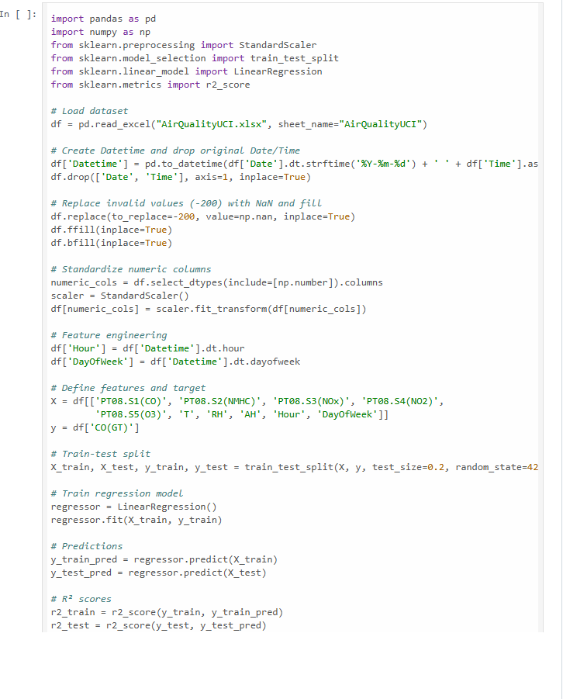
Code

Slide 15
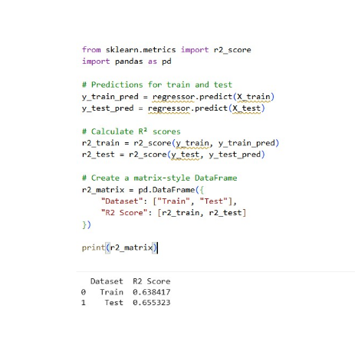
Model Performance Results
Linear Regression Model Performance
Our Linear Regression model achieved an R² score of 0.64 on the training set and 0.65 on the testing set.
This indicates that the model successfully explains approximately 65% of the variance in CO concentration, establishing a moderately effective baseline for air quality prediction.

Slide 16

Thank You!
For more information or collaboration inquiries, please reach out.
We appreciate your interest in our air quality prediction project.

